Slide 1
An introduction to APG traineeships
Our contribution to the future of 4.5 million people living in the Netherlands

Slide 2
Table of contents
Timeline | p. 3
FAQ | p. 4-10
Traineeships | p. 11-20
APG in general | p. 21-29

Slide 3
Timeline selection steps

Slide 4
FAQ

Slide 5
FAQ
1. How competitive is the application process?
The application process is very competitive. In 2024 we had over 800 applicants for 10 positions.
2. What can applicants do to stand out?
Make sure you meet the requirements and that it is conveyed through your cv and letter. Later in the process, ensure that you can effectively present yourself, aligning with the requirements and having your story ready for APG to choose you.
3. What are the key aspects we look for in an ideal trainee candidate during the selection process?
General criteria for all tracks
A clear link (living or studying in, now or in the past) to the Netherlands is a must.
You are willing to take initiative, possess strong interpersonal skills, demonstrate numerical acumen, and exhibit excellent creative problem-solving abilities. Additionally, you have a digital mindset and a keen eagerness to learn.
Fluent mastery of English (fluent Dutch is welcome but not essential).
Extra-curricular development, such as committee or board membership, (voluntary) work will be considered a plus.

Slide 6
FAQ
Traineeship - Finance & Risk | Careers at APG
A master’s degree in Accounting, Controlling, Information Management or Finance, with excellent academic results.
Digitization skills such as R or Python are a plus.
Traineeship - Investment & Portfolio management | Careers at APG
A master’s degree in (sustainable/corporate) Finance (& Investments), Financial Economics, Economics or other relevant studies, with excellent academic results.
Enthusiasm for investments and financial markets.
Motivation and drive to learn how to use tooling such as QlikSense, SAS EG, Alteryx and programming languages such as R, Python, .NET, Azure and C#.
Traineeship – Quant | Careers at APG
A master’s degree in Econometrics, Quantitative Finance, Physics, Mathematics or an equivalent education with excellent academic results.
Affinity with investment and financial markets.
Programming skills with, Python, R or MATLAB.

Slide 7
FAQ
4. On what specific projects or assignments will trainees typically work during the two-year program?
Quant
Focused on long-term insight. Calculating impact of investment strategies on the long-term.
Looking at how the addition of swaptions changes the risk-return profile of the interest rate hedging strategy.
Risk & Finance
Assess valuation models of investment products
Working on the sustainability risk tool
Increase risk awareness in the department supported by data
Creating reports for stakeholders and accountant
(FRM) Financial Risk Manager
Investment & Portfolio Management
As a CIO trainee, you can dive into various exciting projects like performing comprehensive market research in specific sectors, creating an illustrative dashboard to show case the benefits of digitalization, actively participating in ongoing deals and providing support to PMs in their daily responsibilities.

Slide 8
FAQ
5. Can you share examples of career paths that former trainees have taken within the company?
Depending on your assignments and preference, you might start as a
Quant: Researcher in quant teams, or Portfolio Manager or Trader.
Finance & Risk: Business Controller, External Reporting & Evaluation Specialist, Model Validator, Compliance Officer, Risk Manager.
Investment & Portfolio Management: Formal CIO trainees transitioned into the role of Portfolio Managers across various asset classes, such as Infrastructure, Credit, Equity and Thematic Fund.
6. How does APG measure and communicate the impact of its sustainable investments on society?
Within APG Asset Management, we are continuously measuring the impact of our investments by implementing and improving strong ESG methodologies. Additionally, we are also digitally monitoring the societal developments (for example by surveys and web scraping), that impact our work as APG Asset Management.

Slide 9
FAQ
7. How do trainees develop themselves over the course of the 2-year program?
Trainees will cultivate hard skills through engagement in diverse projects. Additionally, participants will undergo a two-year program dedicated to enhancing soft skills, with the option to commence CFA, FDP, or something data related.
8. What are some of the most challenging aspects of this traineeship, and conversely, what are the most rewarding or fulfilling parts, based on feedback from previous trainees?
As you will be part of the team for only six months, convincing your colleagues of new solutions or tools may pose a challenge. Therefore, excelling in stakeholder analysis and honing your persuasiveness skills will be essential. Rewarding is to see the adoption of your (digital) solutions in critical processes, not only within the team but potentially reaching a broader audience within APG Asset Management.

Slide 10
FAQ
9. What is the broader scope of the role and how it aligns with APG's strategic initiatives.
Quant: From digitalization perspective, Quants bring new techniques from the technological and mathematical sides. From the investing side Quants help the transition to more ‘quantdamental’ way of investing which is a mix between fundamental, mainly predominant at APG, and the use of quantitative models and data to make more precise decision in a very competitive ecosystem.
Finance & Risk: The entire CFRO department and its year plan is designed in such a way to fully support each theme of the APG AM Strategy.
Investment & Portfolio Management: The broader scope of being a CIO trainee entails overseeing portfolio management across diverse asset classes, potentially in both public and private spaces. Being a trainee also allows you to dedicate time and effort to sharpen your digitalization skills and to acquire knowledge in the sustainable/responsible investment spaces. This aligns with APG’s overarching goals, fostering sustainable growth, and contributing to long term value creation.

Slide 11
Traineeships

Slide 12
The aim of the APG AM specialist traineeship program is to:
Select and recruit high-potential talents for APG AM
Educate the trainees broadly with the required knowledge
Develop and coach the trainees on the necessary soft skills
Provide guidance to the trainees within the organization
Equip the trainees with the values and principles of APG AM
Shape the trainees to become asset management professionals

Slide 13
Traineeships 2025: 3 tracks
Risk & Finance For those who want to get acquainted with the broad field of finance and risk and want to get started with big data, models, risk analyzes and digital transformation.
Quant The traineeship for those who want to immerse themselves in the world of long-term investing using innovative algorithms.
Investment & Portfolio Management For those who dare to take risks, who can handle responsibility, want to delve into asset classes and contribute to the objectives of APG.

Slide 14
Asset Management Traineeship
October-March
April-September
October-March
April-September
Assignment 1
Assignment 2
Assignment 3
Assignment 4
6 months
6 months
6 months
6 months
Trainee
with support of
Trainer
Trainee coordinator
Field coach
(varies per assignment)
Buddy
Mentor

Slide 15
Salary development
The starting salary on October 1st 2025 is €3970. This is 70 Relative Salary Position (RSP) of our scale 8.
After one year on the first of October 1st 2026 the trainee will get 77 RSP* of scale 8 which is (including CLA salary improvements) €4531.
Download our labour agreement for the scales and more info: APG Groep cao 2024-2026
* There is no increase in the event of underperforming

Slide 16
Benefits:
A guaranteed year-end payment of 8.33% and vacation allowance of 8%.
Monthly vitality contribution of 0.8%.
27 days of vacation
Two “future days” per year. You can use these days for your own future or for society, and they count as working time.
First-class public transport card for commuting.
Option to work in hybrid mode
Reimbursement of study costs, such as CFA certification.
And needless to say, a good pension scheme.

Slide 17
Please note:
That the starting salary (€3970) and weekly working hours (40) are the same for every APG Asset Management Trainee.
The employment contract is for 2-years.
That the start date for this traineeship is 1st of October 2025. This date is fixed and cannot be changed. * These conditions are non-negotiable

Slide 18
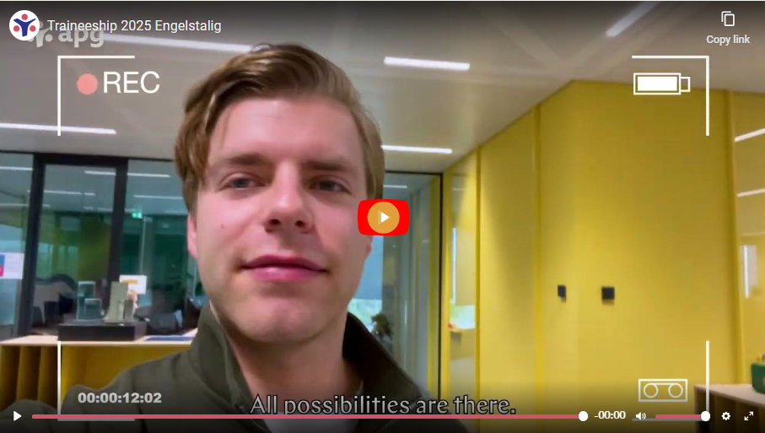
For more personal stories check the video’s of trainees on our website.
https://werkenbij.apg.nl/en/traineeships-at-apg/

Slide 19
Networks for young professionals and/or trainees

Slide 20
Networks for young professionals and trainees at APG
Young APG (< 36 year) Young APG: the community for young professionals at APG | Careers at APG
Trainees discover APG AM
Trainees & Alumni
Global Women's Forum
Connecting Cultures
PROUD
Neuro Unique

Slide 21
APG in general

Slide 22
APG: For today, tomorrow and beyond (video)
​​​​​​​Some four thousand APG employees work hard every day in many ways to ensure the income of the more than five million members of the eight funds that APG serves as pension administrator.
The things that we do at APG and how they affect the lives of over 5 million Dutch people are not that easy to explain. In this video you can see and feel how your income for the future plays a role in everyday life.
Notes:
(ENG: https://youtu.be/J6CpiP3S4Tc)

Slide 23
Who are we?
Largest pension provider in the Netherlands
We look after the pensions of 4.8 million people in the Netherlands
Over 500 billion Euro in pension assets
Over 4,000 employees
More info: APG - A good income for today, tomorrow, and beyond

Slide 24
APG is active worldwide
Amsterdam
Brussels
Heerlen
New York
Hong Kong
Singapore

Slide 25
We don't just have an eye for money
APG strives to provide a good pension in a livable world.
Together we work on a sustainable future in which we do not only look at prosperity, but also at well-being.

Slide 27
One of our main challenges: New rules for pensions in the Netherlands
We are on the way to a new pension system. The new rules will take effect on January 1, 2028 at the latest.
To make this a success, we need to make the transition from the old to the new system in a well-organized manner. We have already started doing this, together with the pension funds we work for.
Preparation for the new pension system is one of the five strategic building blocks for APG on our way to the future.

Slide 28
Our clients
Public sector & education
Construction
APG’s staff pension fund
Housing
Pensioen administration
& Asset Management
Pensioen administration
Cleaning and window cleaning companies
Architects
Work and (re)integration
Medical specialists

Slide 29
Do you see your future with APG?

Slide 30
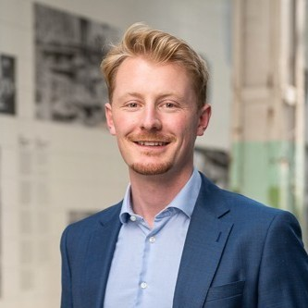
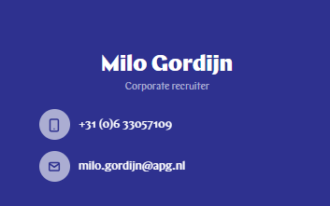
Contact details

